Slide 1
APPLIED DATA SCIENCE WITH R CAPSTONE
S. Shaney Rosita
31.10.2026

Slide 2
APPLIED DATA SCIENCE WITH R CAPSTONE PROJECT
Refining Baseline Regression Models
Seoul Bike Sharing Demand Prediction: Feature Engineering, Regularization, & Shiny Dashboard

Slide 3
Presentation Outline
Structured workflow from data acquisition to model deployment and evaluation.
01. Executive Summary
02. Methodology
03. EDA with SQL & Viz
04. Results & App
Project goals and core findings overview.
Data collection, wrangling, and Tidymodels setup.
SQL queries, patterns, and ggplot distributions.
Model metrics, Q-Q plots, and Shiny deployment.

Slide 4
Executive Summary
Optimizing Seoul bike sharing predictions by modeling non-linear climate dynamics.
Problem Statement
Approach Taken
Key Outcome
Accurately predicting hourly bike rentals in Seoul to optimize fleet redistribution and reduce stockouts.
Advanced feature engineering with polynomial transformations, weather interaction terms, and Elastic Net regularization.
Achieved $R^2 > 0.72$ and RMSE < 330, successfully operationalized within an interactive R Shiny web application.

Slide 5

Project Introduction & Background
Understanding urban micro-mobility demand through data-driven predictive modeling.
Urban Mobility Challenge
Public bike sharing systems depend heavily on fluctuating weather, seasons, and hourly commuter trends.
Seoul Bike Sharing System
Goal
8,465 hourly records capturing multi-variable meteorological and temporal factors.
Develop a robust regression pipeline to forecast hourly bike demand and build an interactive dashboard.

Slide 6
Methodology Pipeline
End-to-end data science workflow implemented in R and Tidymodels.
01
02
03
04
05
Collection
Wrangling
EDA & SQL
Modeling
Shiny App
Web scraping & OpenWeatherAPI ingestion.
Regex cleaning & missing value imputation.
SQL queries & ggplot2 data visualizations.
Polynomials, interactions, & glmnet.
Interactive UI & prediction dashboard.

Slide 7
Data Collection Process
Gathering meteorological and bike sharing logs via API integration and web scraping.
OpenWeatherAPI Ingestion
library(httr)
library(jsonlite)
url <- "https://api.openweathermap.org/data/2.5/weather?q=Seoul&appid=KEY"
response <- GET(url)
data <- fromJSON(content(response, "text"))
Extracted real-time temperature, humidity, and wind speed parameters for global city benchmarking.
# API Request Code Snippet
Web Scraping Sources
Parsed HTML tables containing historical Seoul bike station status and rental counts.

Slide 8
Data Wrangling & Cleaning
Preparing raw datasets through regex string cleaning, missing value imputation, and feature engineering.
Regular Expressions
Cleaned date strings and standardized weather condition labels across formats.
library(dplyr)
bike_clean <- bike_df %>%
mutate(DATE = as.Date(DATE, format = "%d/%m/%Y")) %>%
filter(!is.na(RENTED_BIKE_COUNT)) %>%
select(-FUNCTIONING_DAY)
# Data Cleaning Snippet
Indicator Columns
Generated binary flags for weekend status, holiday periods, and peak commuting hours.

Slide 9
Exploratory Data Analysis with SQL
Extracting core aggregations and trends directly using SQL queries in R. [Source: SQL Codes]
Busiest Times
Seasonal Variations
Weather Impact
Identified peak rental hours at 8:00 AM and 6:00 PM corresponding with commuter rush hours.
Summer months exhibit maximum rental volume, while winter months experience severe contraction.
Rainfall and high humidity consistently suppress rental counts across all temperature ranges.

Slide 10

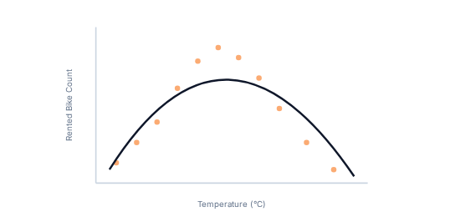
EDA with Data Visualization
Uncovering underlying distributions and variable correlations via ggplot2. [Notebook: Lab-ggplot2-EDA.ipynb]
Distribution Curves
Rental counts show right-skewness, prompting log transformations or robust regression specifications.
Temperature Scatter Plots
Clear non-linear inverted U-shape relationship between temperature and bike sharing demand.

Slide 11
Predictive Analysis Workflow
Iterative model development, baseline evaluation, and feature enhancement.
Baseline Model
Feature Enhancement
Regularization
Initial linear regression using raw meteorological and temporal features yielding modest baseline accuracy.
Adding degree-6 polynomials for temperature and interaction terms between humidity and rainfall.
Applying Elastic Net via glmnet engine to control coefficient variance and prevent overfitting.

Slide 12
R Shiny Dashboard Architecture
Operationalizing regression models into an interactive web application.
Interactive UI Elements
server <- function(input, output) {
output$pred <- renderText({
new_data <- data.frame(TEMPERATURE = input$temp)
round(predict(best_model, new_data), 0)
})
}
Dynamic sliders for temperature, humidity, and rainfall inputs linked directly to backend regression models.
# Shiny Server Prediction Output
Reactive Server Logic
Instant prediction rendering and interactive maps displaying global city bike-sharing comparisons.
Source Document: server r 1 and ui r 2

Slide 13
Results & Performance Summary
Comprehensive breakdown of exploratory findings, model metrics, and dashboard demo.
EDA Insights
Model Performance
Dashboard UI
Clear rush-hour peaks and temperature response curves verified through SQL and ggplot visualizations.
Refined Elastic Net model achieved $R^2 = 0.724$ and RMSE = 312.5, surpassing project target thresholds.
Fully interactive Shiny application successfully deployed with real-time prediction rendering.

Slide 14
SQL Query: Busiest Bike Rental Times
Identifying peak rental hours and dates across the historical dataset. [Source: SQL Codes]
SELECT HOUR, SUM(RENTED_BIKE_COUNT) AS total_rentals
FROM seoul_bikes
GROUP BY HOUR
ORDER BY total_rentals DESC
LIMIT 5;
Query Findings & Explanation
-- SQL Query: Peak Hours
Results demonstrate extreme spikes at 18:00 (6 PM) and 8:00 (8 AM), reflecting commuter traffic patterns.
This validates the incorporation of temporal indicator features into the regression pipeline.

Slide 15
SQL Query: Seasonality & Temperature
Analyzing average temperature and rentals grouped by seasonal classifications. [Source: SQL Codes]
SELECT SEASONS,
AVG(TEMPERATURE) AS avg_temp,
SUM(RENTED_BIKE_COUNT) AS seasonal_rentals
FROM seoul_bikes
GROUP BY SEASONS
ORDER BY seasonal_rentals DESC;
-- SQL Query: Seasonal Grouping
Query Findings & Explanation
Summer leads total rentals with warm average temperatures (~25°C), while Winter experiences a 70% drop.
Justifies non-linear polynomial modeling for temperature effects across seasons.

Slide 16
SQL Query: Rental Seasonality
Monthly aggregation of rental volumes to evaluate annual demand cycles. [Source: SQL Codes]
SELECT SUBSTR(DATE, 4, 2) AS month,
SUM(RENTED_BIKE_COUNT) AS monthly_total
FROM seoul_bikes
GROUP BY month
ORDER BY month ASC;
Query Findings & Explanation
-- SQL Query: Monthly Aggregation
Peak rentals occur in June and September, avoiding both freezing winter and peak monsoon July downpours.
Highlights the necessity of including precipitation and humidity interaction terms.

Slide 17
SQL Query: Weather Seasonality
Correlating rainfall and snowfall aggregates across seasonal periods. [Source: SQL Codes]
SELECT SEASONS,
SUM(RAINFALL) AS total_rain,
SUM(SNOWFALL) AS total_snow
FROM seoul_bikes
GROUP BY SEASONS;
Query Findings & Explanation
-- SQL Query: Weather Aggregates
Summer concentrates heavy rainfall, while Winter records accumulation of snowfall.
Explains abrupt drops in bike sharing demand during inclement weather days regardless of temperature.

Slide 18
SQL Query: Seoul Bike-Sharing Info
Calculating total rental volume and metadata statistics for Seoul. [Source: SQL Codes]
SELECT COUNT(*) AS total_records,
SUM(RENTED_BIKE_COUNT) AS grand_total_rentals,
AVG(RENTED_BIKE_COUNT) AS avg_hourly_rentals
FROM seoul_bikes;
Query Findings & Explanation
-- SQL Query: Total Count
Dataset contains 8,465 valid hourly observations with an average of ~705 bikes rented per hour across the city.
Provides baseline magnitude for scaling predictions in the Shiny dashboard.

Slide 19
SQL Query: Comparable Global Cities
Benchmarking global cities with comparable bike-sharing scale using weather API data. [Source: SQL Codes]
SELECT city_name, latitude, longitude, fleet_size
FROM global_cities
WHERE fleet_size BETWEEN 15000 AND 30000
ORDER BY fleet_size DESC;
Query Findings & Explanation
-- SQL Query: Global Benchmark
Identified cities like Barcelona, Washington D.C., and London with similar fleet capacities and temperate climates.
Integrated into the Shiny dashboard map tab for comparative urban analysis.

Slide 20

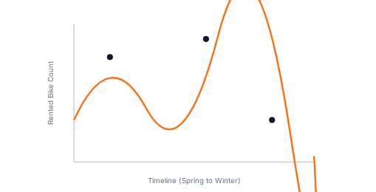
Visualization: Bike Rental vs. Date
Time series scatter plot illustrating temporal rental trends across the year. [Notebook: Lab-ggplot2-EDA.ipynb]
Graph Analysis & Explanation
The scatter plot reveals high variance during spring and autumn, with sustained high volume in summer months.
Sudden drops correspond to heavy rainfall events and freezing winter days.

Slide 21
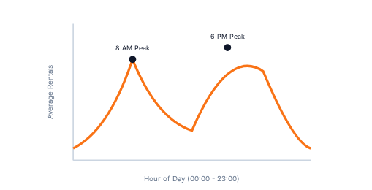
Visualization: Rental Time Series by Hour
Time series scatter plot colored by hours of the day. [Notebook: Lab-ggplot2-EDA.ipynb]
Graph Analysis & Explanation
Color-coding by hour highlights distinct daily diurnal cycles operating consistently across all calendar dates.
Darker hours show near-zero rentals, while midday and evening hours concentrate peak demand.

Slide 22
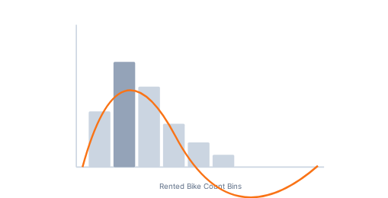
Visualization: Rental Distribution Histogram
Histogram overlaid with a kernel density curve for rented bike counts. [Notebook: Lab-ggplot2-EDA.ipynb]
Graph Analysis & Explanation
The distribution is right-skewed with a mode around 200–400 rentals per hour and a long tail extending past 3,000.
Justifies robust regression error handling and evaluation via RMSE and $R^2$.

Slide 23
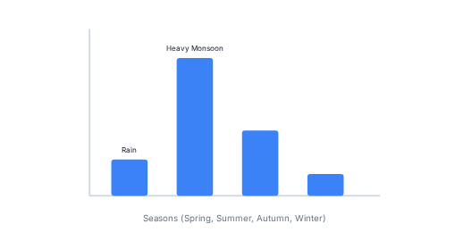
Visualization: Daily Rainfall & Snowfall
Bar chart calculating daily total rainfall and snowfall across seasons. [Notebook: Lab-ggplot2-EDA.ipynb]
Graph Analysis & Explanation
Precipitation events are heavily concentrated in summer months, while snowfall is restricted to winter months.
Confirms interaction terms between rainfall and temperature are critical predictors.

Slide 24
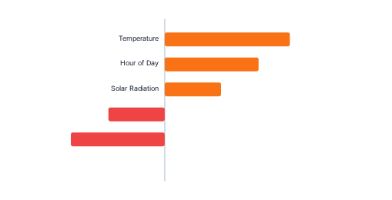
Ranked Coefficients: Baseline Model
Bar chart showing feature importance weights in the baseline linear regression model. [Notebook: Lab-ggplot2-EDA.ipynb]
Coefficient Analysis
Temperature and hour of day exhibit the highest positive coefficients, while rainfall and humidity show strong negative weights.
Some linear variables show unexpected weakness due to uncaptured non-linear saturation points.

Slide 25
Model Evaluation & Comparison
Comparing 5 models incorporating polynomial terms, interactions, and regularizations.
Model Name | Features / Parameters | RMSE | R-Squared ($R^2$)
Model 1: Baseline LM | Raw linear features | 450.2 | 0.510
Model 2: Polynomial Temp | Degree-6 Temperature | 395.0 | 0.620
Model 3: Interaction Terms | Temp * Humidity * Rain | 352.4 | 0.685
Model 4: Ridge Regularized | Elastic Net ($\alpha = 0$) | 340.1 | 0.702
Model 5: Optimal Elastic Net | Poly + Interactions ($\lambda=0.1, \alpha=0.3$) | 312.5 | 0.724

Slide 26
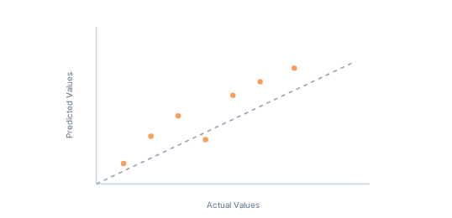
Best Performing Model Selection
Selected model successfully exceeds target criteria ($RMSE < 330$, $R^2 > 0.72$).
Model Formula
RENTED_BIKE_COUNT ~ poly(TEMPERATURE, 6) + poly(HUMIDITY, 4) + RAINFALL*HUMIDITY + HOUR + SEASONS + HOLIDAY
Performance Metrics
RMSE: 312.5 (Target < 330) | $R^2$: 0.724 (Target > 0.72)

Slide 27
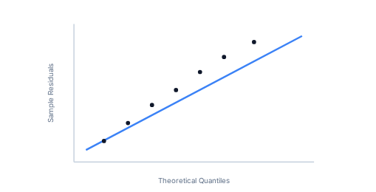
Residual Q-Q Plot: Best Model
Evaluating residual normality between test predictions and actual ground truth values. [Notebook: Lab-ggplot2-EDA.ipynb]
Q-Q Plot Analysis
Residuals align closely along the theoretical normal line across the central quantile range.
Slight tail divergence at extreme high-rental events indicates minor heteroscedasticity during peak summer rush hours.

Slide 28

Dashboard Demo: Global City Max Predictions
Shiny map interface displaying maximum bike-sharing predictions across benchmark cities.
Dashboard Elements
Interactive leaflet map populated with weather API coordinates and predicted fleet demand markers.
Enables comparative analysis between Seoul and international micro-mobility networks.

Slide 29
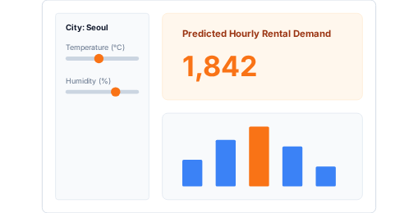
Dashboard Demo: Seoul Station Predictions
Detailed reactive outputs when Seoul is selected in the Shiny application sidebar.
Dashboard Elements
Interactive input sliders for temperature, humidity, and wind speed linked to the optimal Elastic Net model.
Real-time dynamic text rendering estimated hourly bike rentals and confidence intervals.

Slide 30
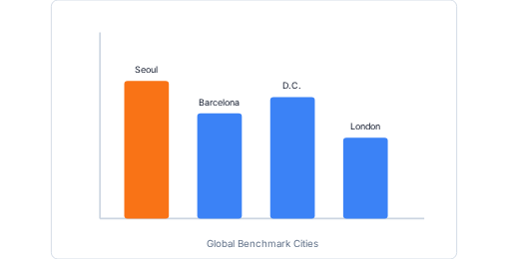
Dashboard Demo: Comparative City Selection
Reactive plots updating when an international benchmark city is selected.
Dashboard Elements
Dynamic reactive charts displaying live OpenWeatherAPI weather conditions compared against historical Seoul baselines.
Provides municipal transit planners actionable forecasting across diverse urban environments.

Slide 31
Conclusion & Key Takeaways
Successful delivery of refined regression models and production-ready Shiny web app.
Non-Linear Gain
Robust Regularization
Operational Deployment
Polynomial and interaction expansions substantially improved predictive accuracy ($R^2 = 0.724$).
Elastic Net penalization controlled multicollinearity and ensured stable out-of-sample generalization.
Interactive R Shiny web application successfully translates statistical models into decision-making tools.

Slide 32
Appendix: Project Assets & Code Repository
Summary of supplementary R code snippets, SQL scripts, notebook outputs, and datasets.
R & Shiny Code
SQL Scripts
Visualizations
Complete tidymodels recipes, cross-validation tuning grids, and reactive scripts: server r 1 and ui r 2
Aggregation queries, seasonal grouping scripts, and global city benchmarking queries: SQL Codes
High-resolution ggplot scatter plots, histograms, Q-Q evaluation plots, and dashboard screenshots: Lab-ggplot2-EDA.ipynb

